Slide 1
Steering Meeting 6
Group 1
Notes:
W5

Slide 2
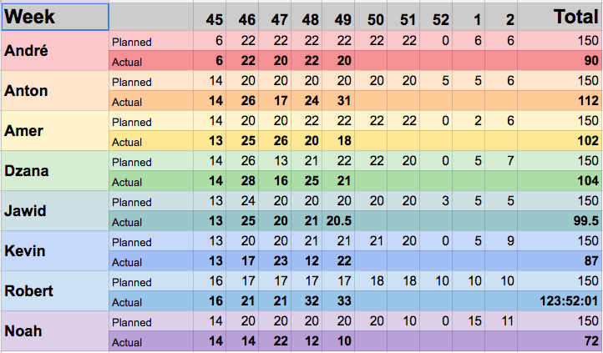
Time Tracking

Slide 3
Week 49 Summary
Presentation and preparation
Creation of Model and Migration (projects and artifacts)
Implementation of check for card changes during board run time
Improving of project plan
Styling of login page and all category pages
TeamForge validation to login
Upgrade the board update functionality to use broadcast and radios (Not done)
New label and milestone for out of scope.

Slide 4
Previous Week (W5)
Closed
_Implementation_ _Design_ Out of scope _Projectplan_
11 issues 2 issues 1 issue 1 issue
39.5 hours 27 hours 8 hours 3.5 hours

Slide 5
Previous Week (W5)
Closed
Frontend | Backend | Others
2 issues 5 hours | 8 issues 33.5 hours | 1 issue 1 hours

Slide 6
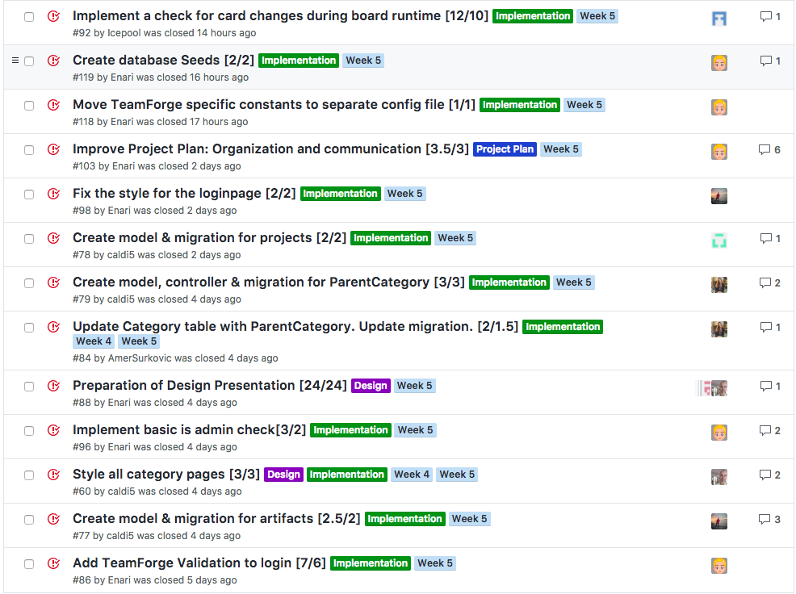
Previous Week

Slide 7
Tasks still open from previous week
No tasks

Slide 8
Tasks moved from previous week

Slide 9
Tasks moved from previous week

Slide 10
Next Week
_Implementation_ | _Design_ | Both
10 issues 69 hours | 0 issues 0 hours | 1 issue 60 hours

Slide 11
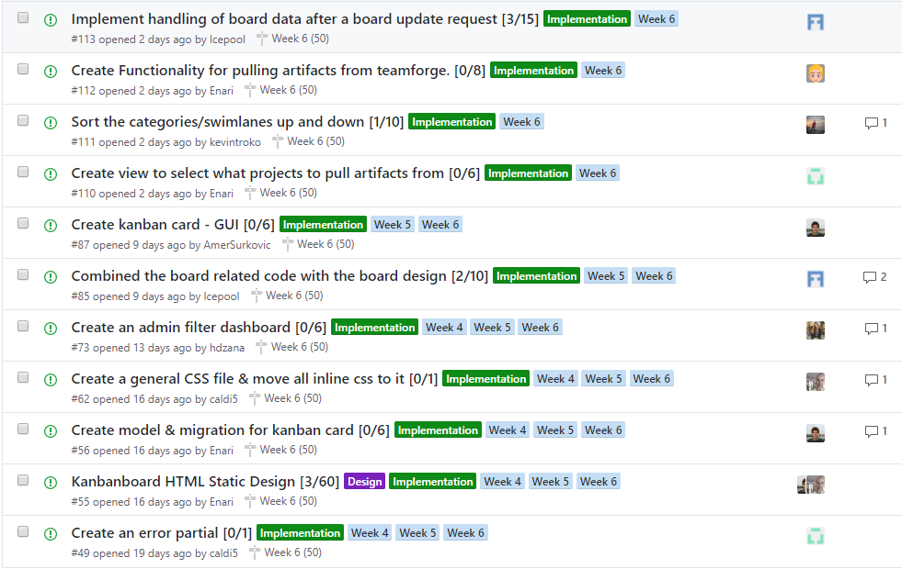
Next Week's Issues

Slide 12
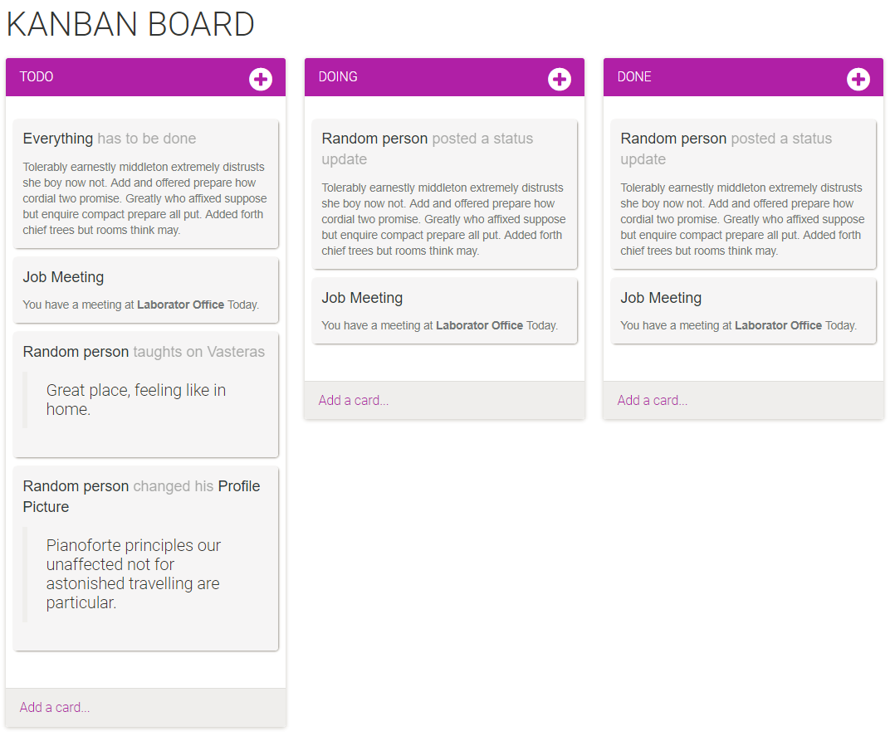

Slide 13
Questions for us?
Notes:
Taco night on friday

